Slide 1
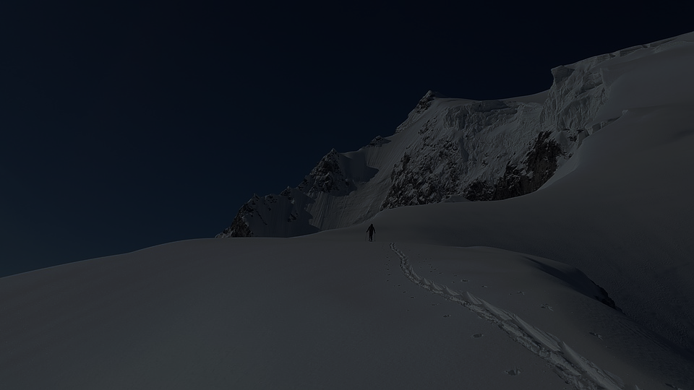
SAP Analytics cloud training
Anurag Bajaj
Shubham Singh
Day 6

Slide 2
Agenda – Day 6
Advance Planning Scenario – Hands on
- Distribution and Spreading
- Working with Formulas
- Working with allocations
- Allocations on calculated measure
---Break---
Value Driver Trees – Hands on
- Create Value Drive Trees
- Using VDT in the dashboard

Slide 3

Formulas
Gross Margin %(KPI01) = Gross Profit (H105000) / Net Revenue (H110000)
Operating Profit %(KPI02) = Operating Income (H105000) / Net Revenue (H110000)
Operating Expense Ratio %(KPI03) = Operating Expenses (H105000) / Net Revenue (H110000)
www.anubhavtrainings.com

Slide 4
Allocations
In the past we saw the concept of distribution, Allocation is actually a distribution but it depends on another dimension how the values will be distributed.
I have ordered 10 Pizzas = 50% home, 50% office – 5,5 – Distribution
Allocation is a distribution based on another measure/dimension
Factor – No. of members is called as allocation driver
8 members @ office , 2 members @home
Allocate based on No. of members === 8 Pizzas to office and 2 to home
www.anubhavtrainings.com

Slide 5
Allocation – how to create
Allocation
Steps
Rules
www.anubhavtrainings.com

Slide 6
Scenario 1 : Simple Allocation
Company had recently planned for expansions in the other regions of USA. We have hired the colleagues and now they need to start product marketing, we have meeting with marketing heads of each region. We want to allocate budget for marketing expenses based on number of hires (FTE) in each region. This type of requirement is called Allocations.
- Create New version from Actuals called Marketing_Exp_FTE
- Expand and observe that Marketing Expenses except northeast region for USA is not allocated
- Show unbooked data of USA Regions
- Create new Process→Allocation Step
- Define Step the Rule in the step
Allocation Rule
Source - Enterprise>United States >Northeast
Driver - FTE
Target - Enterprise>United States
www.anubhavtrainings.com

Slide 7
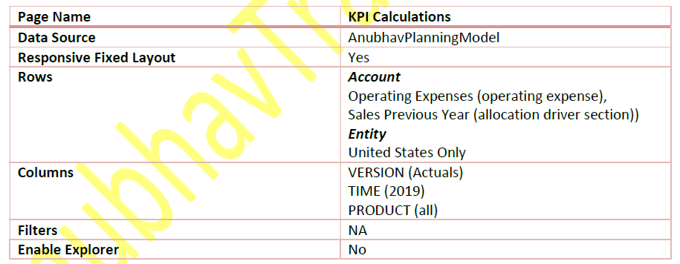
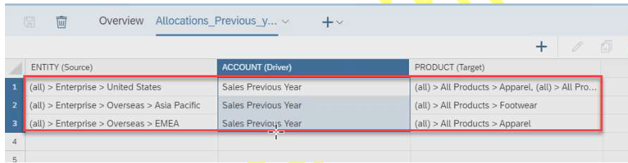
Scenario 2 : Allocate conditionally
The leads of each marketing zone’s now go back to their respective regions, the company have given them the target to sell the products, they are confused about how do they spend the budget provided for their region at the product level now. One good idea is to look at last year sales of the products and based on that allocate budget for each product accordingly. This allocation is intended to demonstrate that we can create allocations based on calculated values as well. The company is only in Apparel business in EMEA and Footwear business in APJ hence make sure we run the allocations accordingly.
Sales Previous Year (DRV0110) = LOOKUP([H111100] , [d/TIME]= Previous("Year",1))
Gross Sales(H111100) WHERE Time = Previous 1 Year
- Create New version from Actuals called OPEX_By_LAST_Sales
- Expand and observe that Operational Expenses for products
- Show unbooked data of all Regions
- Create new Process→Allocation Step
- Define Step the Rule in the step
Allocation Rule
www.anubhavtrainings.com

Slide 8
Value Driver Tree
Value driver trees (VDTs) allow visualizing the composition of a KPI and its contributing factors
▪ A VDT shows how a KPI is calculated from other KPIs and drivers
▪ In SAC, a value driver tree can be used to visualize existing data but also to simulate the impact of driver
changes in real time
▪ In planning, the VDT component can be used to create and simulate different scenarios
▪ Value driver trees are provided as standard story widgets and can be seamlessly integrated into SAC stories
The value driver tree is a physical representation of interdependencies in measures that is used to generate a simulated effect of changing an underlying measure onto its parent. SAP Analytics Cloud allows for slider inputs to change metrics and recalculates the whole model on its outcome. Very, very powerful and extremely helpful for simulation and planning purposes.
www.anubhavtrainings.com

Slide 9
Creating a VDT
▪ A value driver tree is a standard widget in the story
▪ VDT widgets can be configured like any other story widget by adding a new component and then using the builder panel
▪ A VDT is based on a data model. The nodes of the tree correspond to KPIs defined in the account dimension
▪ You can automatically generate a value driver tree from an existing model
▪ Alternatively, you can start building the tree from scratch, defining the nodes manually
www.anubhavtrainings.com

Slide 10
End of Day 6

Slide 11

Questions

Slide 12

Anurag Bajaj
anurag.bajaj02@gmail.com

